Slide 1
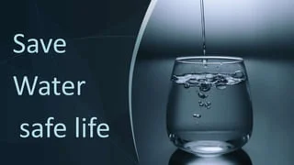

SAVE WATER
SAVE LIFE
Presented By: Deepa
Trade: AIPA
Institute: NSTI(W) Allahabad

Slide 2
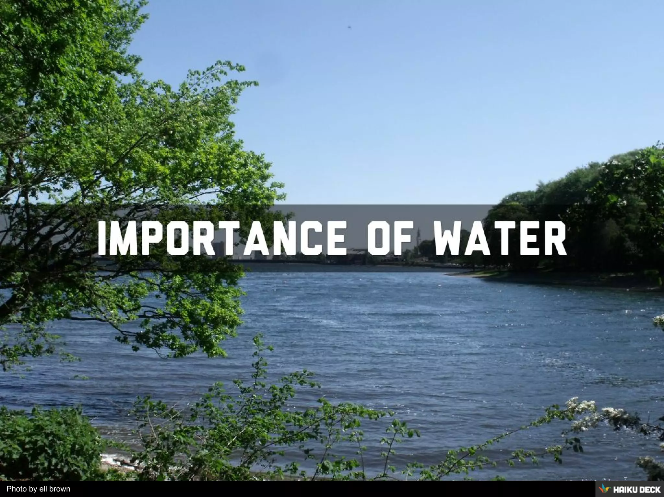
Importance Of Water
Water is essential for all living organisms.
It is necessary for drinking and cooking.
Water is important for agriculture and food production.
Industries use water for many processes.
Clean water helps maintain good health and hygiene.
Water supports plants, animals and ecosystems.

Slide 3
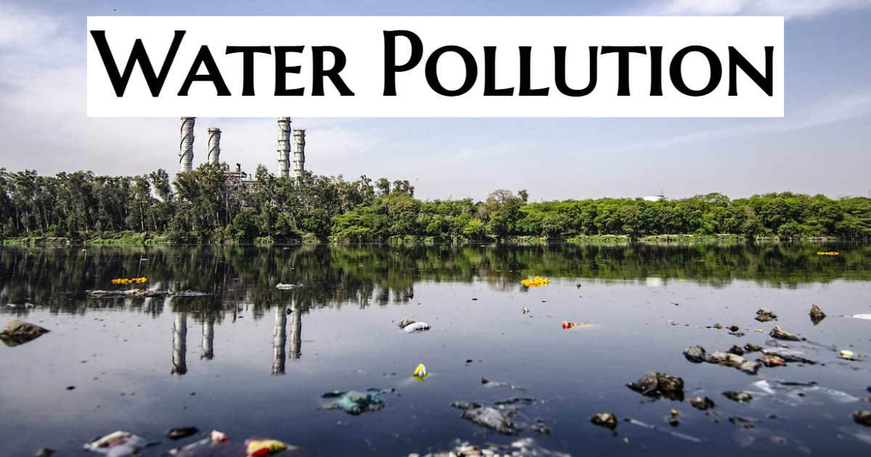
Current Water Challenges
Increasing water scarcity
Groundwater depletion
Water pollution
Irregular rainfall
Climate change
Unequal access to clean water
Increasing demand due to population growth

Slide 4
Major Causes Of Water Wastage
Tap
Shower
Car
Agriculture
Factory
🚰 Leaking Taps and Pipes
🚿 Long Showers
🚗 Washing Vehicles with Excess Water
🌾 Over-Irrigation
🏭 Industrial Water

Slide 5
Water Conservation Methode
Save Water at School
Save Water at Home
Community Action
Turn off taps after use.
Report leaking taps and pipes.
Avoid wasting drinking water.
Use water carefully while cleaning.
Spread awareness among students.
Organize water conservation activities.
Turn off the tap while brushing.
Fix leaking taps and pipes.
Take shorter showers.
Reuse water for plants and cleaning.
Use a bucket instead of a hose.
Collect rainwater for gardening.
Organize water conservation awareness campaigns.
Promote rainwater harvesting.
Keep rivers, ponds and lakes clean.
Encourage people to reduce water wastage.
Plant more trees to protect water resources.

Slide 6

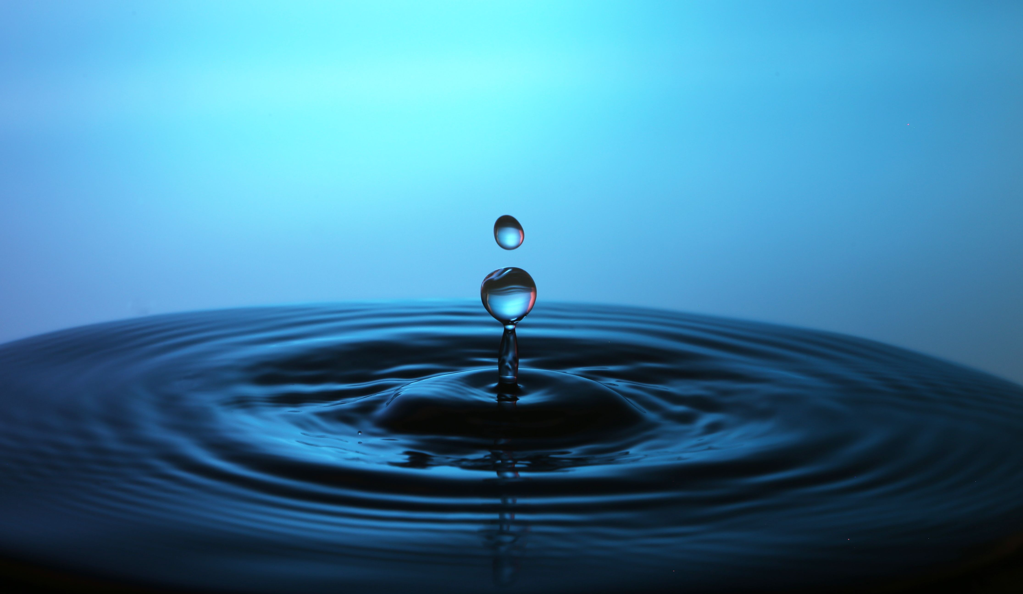
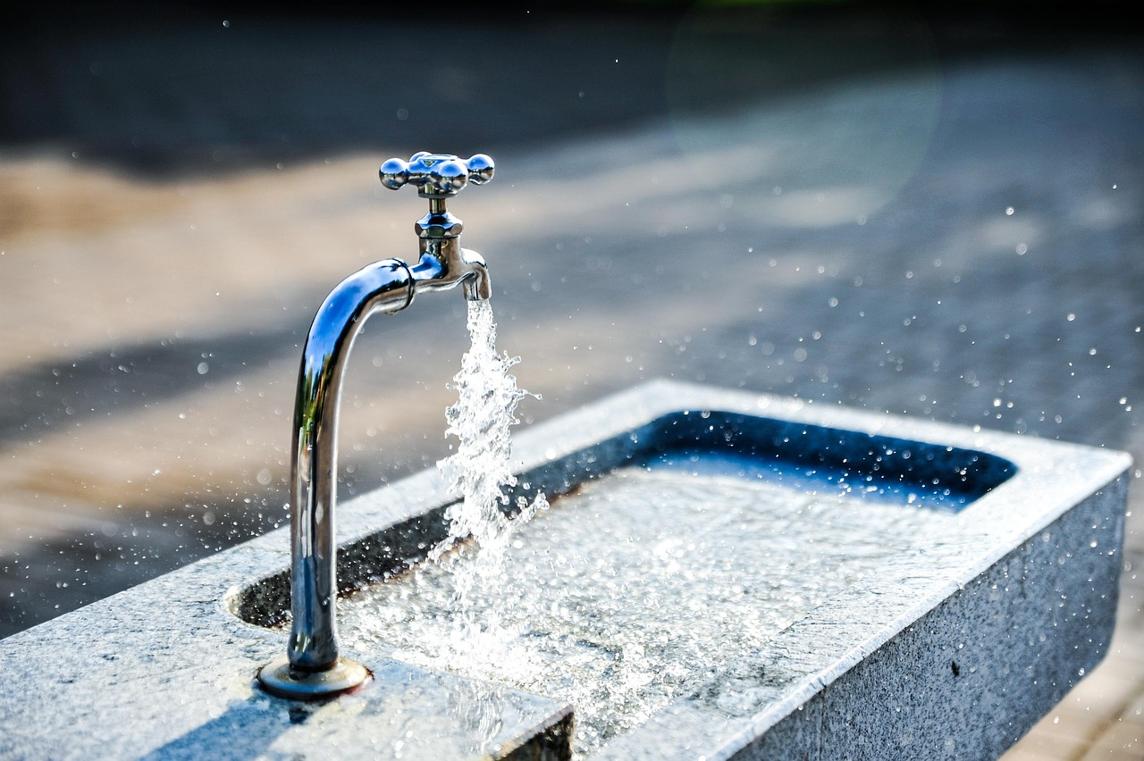
Water Conservation at Home
Turn off the tap while brushing.
Take shorter showers.
Repair leaking taps and pipes.
Reuse water whenever possible.
Use a bucket instead of a hose for washing vehicles.
Run washing machines with full loads.
Collect rainwater for gardening.
This Photo by Unknown Author is licensed under CC BY-NC-ND

Slide 7
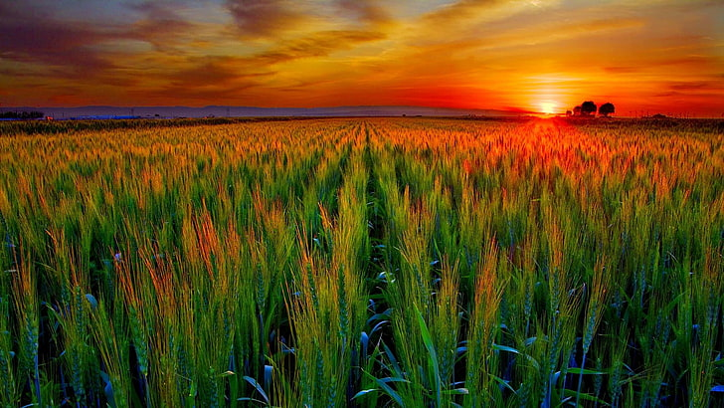
Water Conservation Methode
Traditional Methode | Water –Saving Methode
Flood Irrigation | Drip Irrigation
Excess Water Use | Controlled Water Use
Open Water Channel | Efficient Irrigation
Frequent Irrigation | Need-Based Irrigation

Slide 8
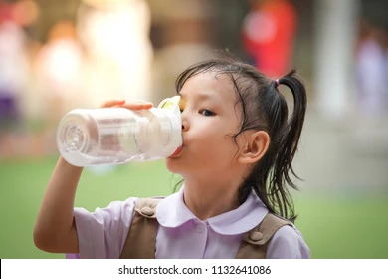
Roles Of Students
Our Responsibility
Spread awareness about saving water.
Avoid wasting water at school and home.
Participate in cleanliness and water conservation drives.
Encourage friends and family to save water.
Report leaking taps and pipes.
Speaker Notes
Students can play an important role in saving water. By developing good habits and spreading awareness, students can encourage their families and communities to use water responsibly.

Slide 9
Do’s and Don’ts
Do’s
Don’ts
Turn off taps properly.
Repair leaks immediately.
Reuse water whenever possible.
Collect rainwater.
Use water carefully.
Don't leave taps running.
Don't waste drinking water.
Don't take unnecessarily long showers.
Don't pollute rivers and lakes.
Don't use excessive water for cleaning.
Speaker Notes
Water conservation starts with our daily habits. We should always use water carefully and avoid unnecessary wastage. We should turn off taps, repair leaks, reuse water when possible, and collect rainwater. Never leave taps running or pollute rivers and lakes. Small actions by everyone can help save a large amount of water.

Slide 10
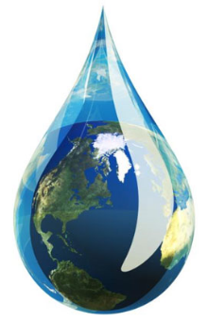

Conclusion & Thank You
Water is one of our most valuable natural resources.
Every drop of water is important.
Saving water today means protecting our future.
Everyone has a role in water conservation.
Save Water, Save Life!
Thank You
“Save Water Today for a Better Tomorrow.”

Slide 11


